Slide 1
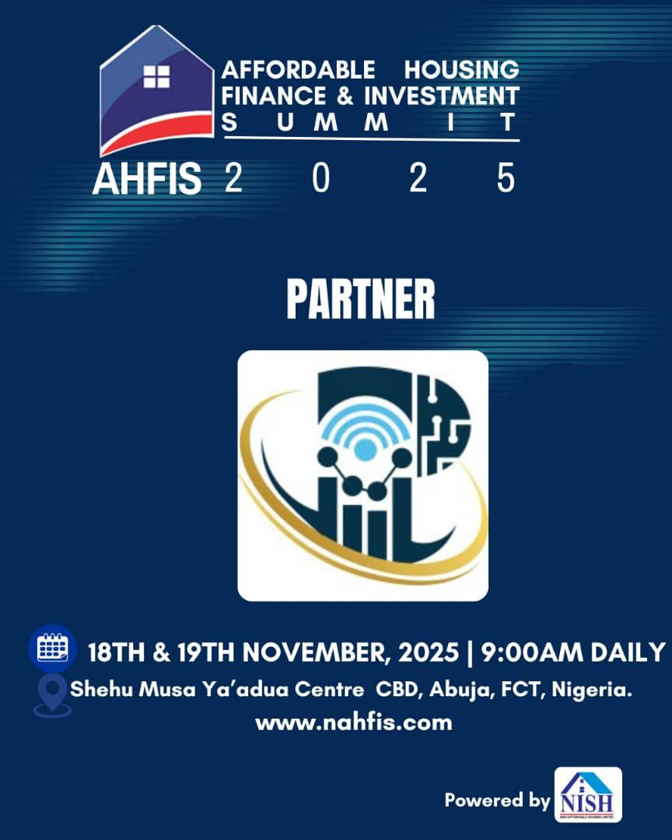
Title Slide
Reimagining Affordable & Inclusive Housing Finance
Mr. Adedeji J. Adesemoye
Founder/CEO, Plural Crown Ltd
18–19 Nov 2025, AHFIS Summit & Expo
Slide 1

Slide 2
Presentation Outline
1. Context & Opening
2. Income-Based Segmentation (NBS/NPC)
3. Affordability Realities
4. Structural Finance Pathway
5. Mortgage Liquidity Facility
6. Blended Finance Options
7. RMBS & Housing Microfinance
8. Green/Social Housing & Title Reforms
9. Summary & Closing
Slide 2

Slide 3
Context & Opening
• Nigeria’s housing challenge is recognized but deficit figures vary.
• Focus instead on NBS & NPC verifiable economic data.
• Income distribution shows where affordability gaps exist.
• The solution lies in structural housing finance.
Slide 3

Slide 4
Who Needs Housing Support? (Corrected Segmentation)
NBS/NPC Income Segmentation (Total 100%):
• Low-income: 50% (₦30k–₦100k/month)
• Emerging middle-income: 35% (₦120k–₦400k/month)
• Formal middle class: 12% (₦400k–₦1.8m/month)
• Upper-middle & diaspora: 3%
Affordability solutions must reflect these bands.
Slide 4

Slide 5
Affordability Reality (NBS Data)
• 70%+ cannot access conventional mortgages.
• House prices (₦5m–₦40m) exceed median affordability.
• Short-tenor loans inflate monthly repayment.
• Weak land-title systems limit collateral use.
Slide 5

Slide 6
Structural Finance Approach
Transforming affordability through:
• Liability restructuring.
• RMBS to recycle mortgage capital.
• Housing Microfinance for incremental building.
• Blended finance combining domestic, global & diaspora.
Slide 6

Slide 7
Mortgage Liquidity Facility
• Provides long-term refinancing (15–25 years).
• Reduces repayment pressure for households.
• Strengthens PMBs & lenders with stable capital.
• Backed by NHF, PFAs, insurers & diaspora funds.
Slide 7

Slide 8
Blended Finance Pathway
Capital mix for affordability:
• Domestic PFAs/NHF = stability.
• Global green/social funds = low-cost long-term capital.
• Diaspora = additional long-tenor FX support.
Result: lower interest rates + expanded access.
Slide 8

Slide 9
RMBS: Expanding Mortgage Capacity
• Converts mortgage pools into investible securities.
• Attracts PFAs, insurers, ESG investors.
• Frees lender balance sheets.
• Supports nationwide uniform underwriting.
Slide 9

Slide 10
Housing Microfinance (Incremental Building)
• ₦200k–₦5m progressive construction loans.
• Best fit for 50% low-income & informal sector.
• Mirrors how most Nigerians already build.
• Fast, scalable, and inclusive.
Slide 10

Slide 11
Green & Social Housing Finance
• Unlocks climate funds (GCF, PFAN, EU bonds).
• Cheaper borrowing costs for energy-efficient homes.
• Encourages developers to adopt green designs.
• Aligns with global housing sustainability.
Slide 11

Slide 12
Land Titling, Governance & Consumer Education
• Digital titles improve collateral value.
• FHA–FMBN–FHFL–State alignment improves efficiency.
• Consumer education boosts mortgage uptake.
• Technology strengthens transparency.
Slide 12

Slide 13
German EFBS Bauspar Savings–Loan Model
• A contractual savings system where households save monthly for 2–5 years.
• Savings unlock a guaranteed low-interest housing loan.
• Builds credit discipline for low-income earners.
• Ideal for rent-to-own, cooperative housing & incremental construction.
• Can be integrated under NHF, PMBs & microfinance operators.
Slide 13

Slide 14
Convertible Housing Bonds (Upper-Middle Class Financing)
• Investors subscribe to housing-linked bonds.
• Bonds convert into mortgage credit or equity in housing SPVs.
• Attractive to diaspora & high-skill earners.
• Provides developers with long-term, non-bank liquidity.
• Supports capital formation for affordable supply.
Slide 14

Slide 15
Rent-to-Own Solutions (Lower-Income Households)
• Best suited for low-income and informal workers.
• Pay monthly rent while gradually building equity.
• Works with microfinance + Bauspar savings model.
• Reduces upfront cost barrier → improves inclusion.
• Can be combined with cooperative housing & state land support.
Slide 15

Slide 16
15‑Minute Summary
• Nigeria can expand affordability using reliable NBS/NPC income data.
• Segmentation identifies who needs what type of support.
• Structural finance—not subsidies—is the scalable path.
• Mortgage liquidity, RMBS, microfinance, and green funding provide scale.
• Land reforms + governance + education complete the ecosystem.
Slide 16

Slide 17
Thank You
Thank you for listening.
Reimagining affordability is possible through structural finance,
long-term capital stability, and institutional alignment.
Slide 17

